Slide 1


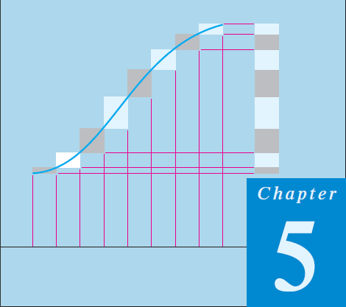
Thomas Calculus 11th
07
Integration Principles
Samuel Lukas

Slide 2
Agenda
Integration Principle
Basic Integration Formulas
Integration by Parts
Integration of Rational Functions
Trigonometric Integrals
Trigonometric Substitutions
The Substitution Z = tan(x/2)
Improper Integrals

Slide 3
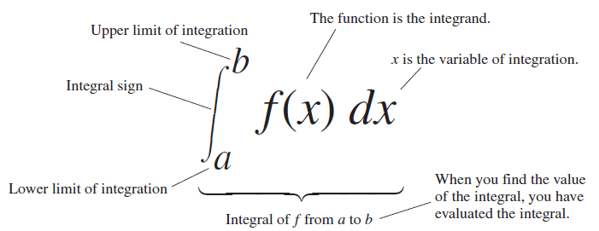
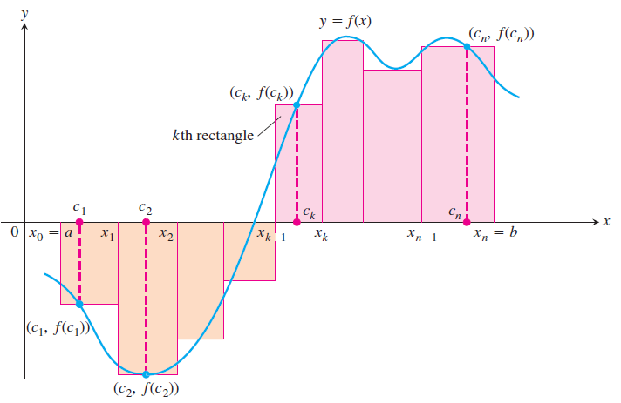
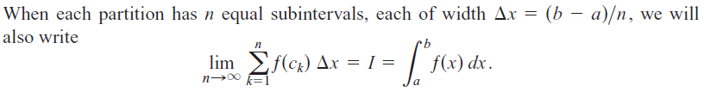
Integration Principle

Slide 4
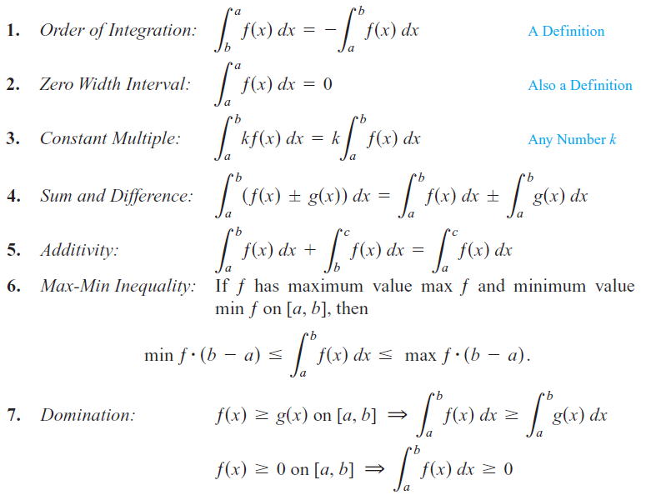
Characteristics of Integration

Slide 5
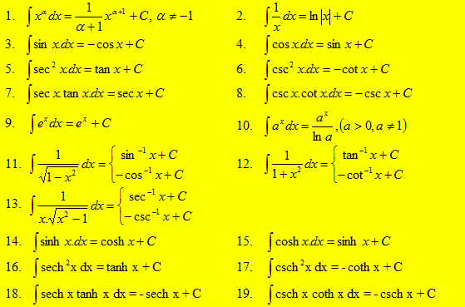
Integration formulas

Slide 6
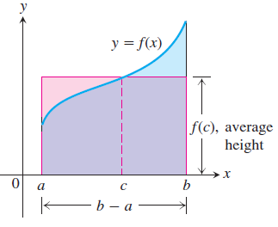
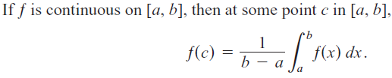
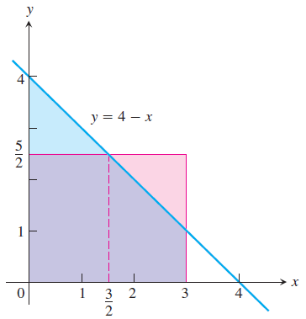

The Fundamental Theorem of Calculus
The Mean Value Theorem

Slide 7
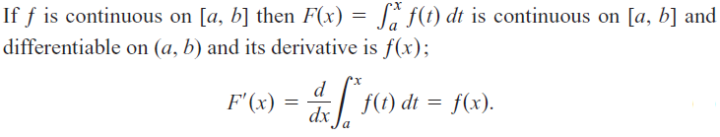
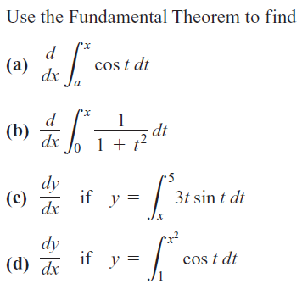







Slide 8
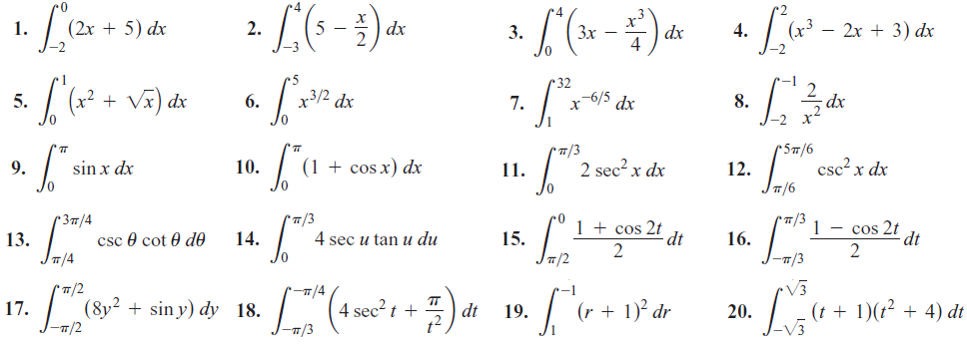
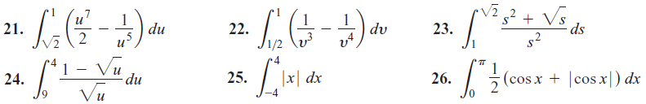
Exercises 1
Evaluate the integrals

Slide 9
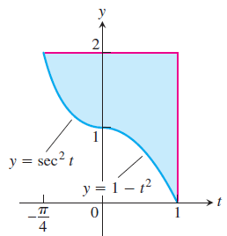
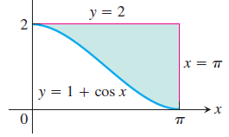
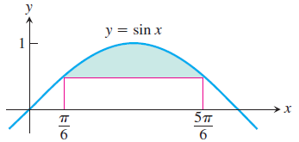
Find the derivatives in Exercises 27–34
a. by evaluating the integral and differentiating the result.
b. by differentiating the integral directly.
In Exercises 35–38, find the total area between the region and the x-axis.
Find the areas of the shaded regions

Slide 10













Basic Integration Formulas
Evaluate :

Slide 11













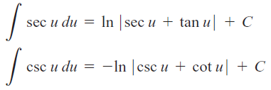

Slide 12















Exercises
Find the values in Exercises 1 – 6.
01
02
03
04
05
06
07
08
09
10
11
12
13
14
15

Slide 13

















16
17
18
19
20
21
22
23
24
25
26
27
28
29
30
31
32

